Slide 1

Cryptography
Module 3

Slide 2
Learning Objectives
To understand basic cryptographic concepts, analysis, techniques, and tools
To be able to gain familiarization of applied cryptography in cyberspace

Slide 3
Topic Outline
Cryptography concepts, theory, and techniques
Caesar, Vignere, and Playfair ciphers
Public key cryptosystems
Information hiding protocol
Digital certificates
Digital signatures
File, directory, and email encryption

Slide 4
Caesar Cipher
Substitution cipher using either
right or left rotation of the alphabet.
Yt gj tw sty yt gj. Ymfy nx ymj vzjxynts!
Using right rotation by 5 places …
To be or not to be. That is the question!

Slide 5
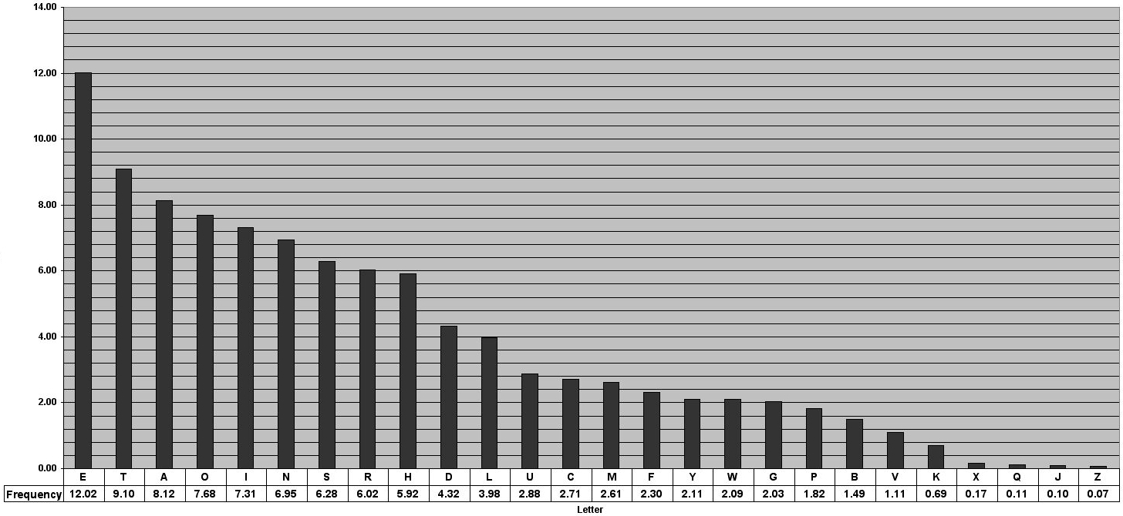
Letter Frequency

Slide 6
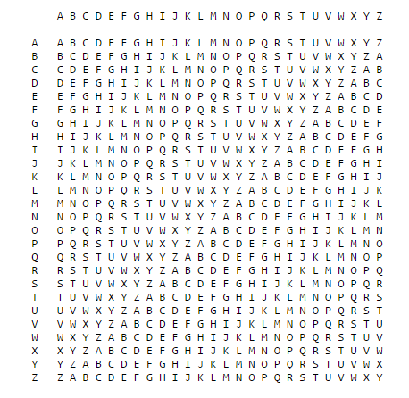
Vignere Cipher
http://www.gosoapbox.com
Event code: 288095730
Poly-alphabetic substitution cipher using a
keyword and the Caesar cipher multiple times.

Slide 7
Vignere Cipher
Plaintext maps to the columns
Keyword maps to the rows
Cipher is the letter on the intersection
Keyword: R E L A T I O NSRELATIONSRELATIONSREL
Plaintext: T O B E O R N OTTOBETHATISTHEQUESTION
Ciphertext: K S M E H Z B BLKSMEMPOGAJXSEJCSFLZSY

Slide 8
Check for Understanding 1
http://www.gosoapbox.com
Event code: 288095730
Encrypt the following plaintext:
THIS IS AN AWESOME ACTIVITY
Use the keyword CYBER

Slide 9
Check for Understanding 1
http://www.gosoapbox.com
Event code: 288095730
With the following plaintext:
THIS IS AN AWESOME ACTIVITY
and using the keyword CYBER, the ciphertext is
VFJW ZU YO ENGQPQV CAUMMKRZ

Slide 10
Transposition Cipher
Use a keyword to define the transpose.
Plaintext: TO BE OR NOT TO BE THAT IS THE QUESTION
Keyword: C Y B E R
2 5 1 3 4
T O B E O
R N O T T
O B E T H
A T I S T
H E Q U E
S T I O N
Ciphertext: BOEIQI TROAHS ETTSUO OTHTEN ONBTET

Slide 11
Check for Understanding 2
http://www.gosoapbox.com
Event code: 288095730
Decrypt the following ciphertext:
GBACSCACTEPMUSEECASHTYERIUNUNRHMOFJ
Hint: the 5-letter keyword is on this page and there
are 35 letters in the ciphertext!

Slide 12
Check for Understanding 2
The keyword: C R Y P T
1 3 5 2 4
The ciphertext:
G E N C Y
B E R T E
A C H E R
C A M P I
S S O M U
C H F U N
A T J S U

Slide 13
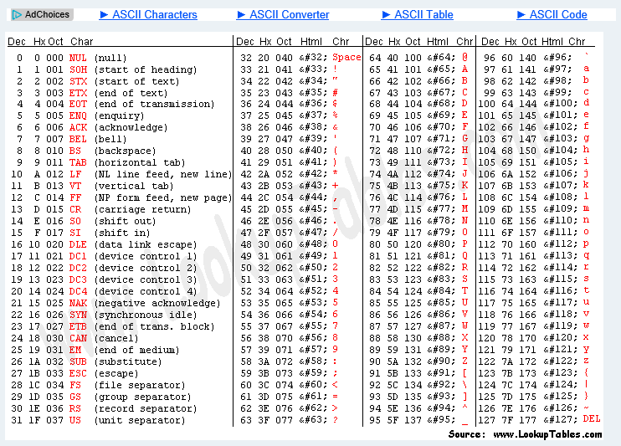
ASCII Values

Slide 14
XOR Cipher
Bit wise operations:
1 ^ 1 = 0 1 ^ 0 = 1 0^ 1 = 1 0 ^ 0 = 0
Plaintext: 01100001 = 97 ← ascii value for ‘a’
Key 01001011 = 75 ← ascii value for ‘K’
__________
Ciphertext: 00101010 = 42 ← ascii value for ‘*’
Ciphertext: 00101010
Key 01001011 = 75 ← ascii value for ‘K’
__________
01100001 = 97
Symmetric Cipher

Slide 15
PLAYFAIR Cipher
Rules….take each pair of letters at a time
1. If both letters are the same (or only one letter is left), add an "X" after the first letter. Encrypt the new pair and continue.
2. If the letters appear on the same row of your table, replace them with the letters to their immediate right respectively (wrapping around to the left side of the row if a letter in the original pair was on the right side of the row).
3. If the letters appear on the same column of your table, replace them with the letters immediately below respectively (wrapping around to the top side of the column if a letter in the original pair was on the bottom side of the column).
4. If the letters are not on the same row or column, replace them with the letters on the same row respectively but at the other pair of corners of the rectangle defined by the original pair. The order is important – the first letter of the encrypted pair is the one that lies on the same row as the first letter of the plaintext pair.

Slide 16
PLAYFAIR Cipher
Using PLAYFAIR EXAMPLE as key
P L A Y F
I R E X M
B C D G H
K N O Q S
T U V W Z
Encrypt the message: “CLOSE RANKS”
CL →NR OS →QR ER →XE AN →LO KS →NK

Slide 17
PLAYFAIR Cipher
Challenge Problem
Using PLAYFAIR EXAMPLE as key
P L A Y F
I R E X M
B C D G H
K N O Q S
T U V W Z
Encrypt the message: “Hide the gold in the tree”

Slide 18
PLAYFAIR Cipher
Using PLAYFAIR EXAMPLE as key
P L A Y F
I R E X M
B C D G H
K N O Q S
T U V W Z
Encrypt the message: “Hide the gold in the tree”
HI → BM DE → OD TH → ZB EG → XD OL → NA DI → BE NT→ KU
HE → DM TR → UI EX → XM

Slide 19
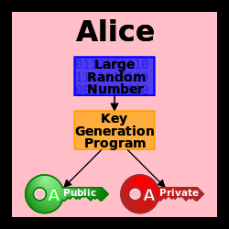
Public Key Cryptosystems
By KohanX (talk) - Own work (Original text: I (KohanX (talk)) created this work entirely by myself.), Public Domain, https://commons.wikimedia.org/w/index.php?curid=24325809

Slide 20
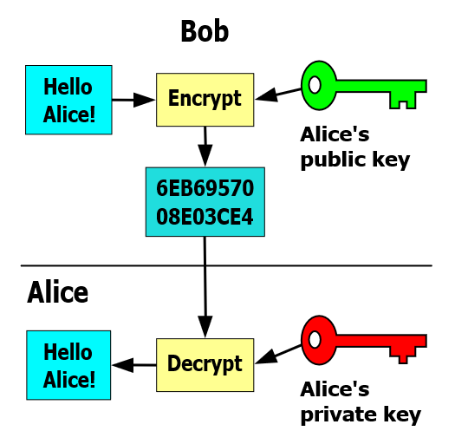
Public Key Cryptosystems
Asymmetric Key Encryption Scheme
Attributed to David Gothberg, Public Domain.

Slide 21
Public Key Cryptosystem
Preserving message integrity:
Sign message with your private key
Send message with digest
Recipient uses your public key to
verify digest

Slide 22
Public Key Cryptosystem
Preserving message confidentiality:
-Sender encrypts message with your
public key
-Sender sends message
-You use your private key to decrypt
the message

Slide 23
Information Hiding Protocol
A technique which allows people
to accurately share personal
Information without having to give
up any privacy at all.

Slide 24
Information Hiding Protocol
Calculate the average age of the group
Start with a random three digit number…
First person add your age to the three digit number, write and pass sum to the next person …
…
Final sum returns to the first person, subtracts the original three digit number, divides by the number of persons….voila!

Slide 25
Check for Understanding 3
http://www.gosoapbox.com
Event code: 288095730
Which principle is implemented by cryptography?
A. Layering
B. Least privilege
C. Information hiding
D. Abstraction

Slide 26
Public key Encryption with GnuGPG
Download the GnuGPG4 Windows: https://www.gnupg.org/download/

Slide 27
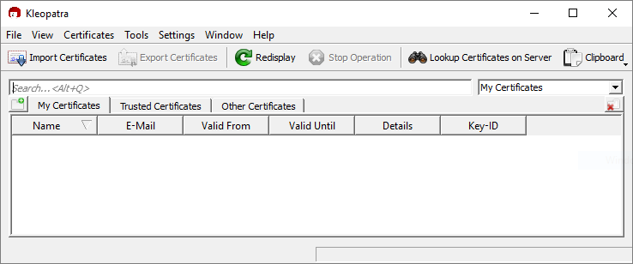
Public key Encryption with GnuGPG

Slide 28
Public key Encryption with GnuGPG
Generate a private and public key
On the menu bar, click on File →New Certificate.
The Certificate Creation Wizard should pop up. Click on “Create a personal OpenPGP key pair.”
Complete the form entries.
On Advanced Settings, make sure RSA is selected and 4096 bits is selected. Also, make sure the Authentication check box is enabled.
Click Next. Then click Create Key. Enter a passphrase.
Click Finish.

Slide 29
Public key Encryption with GnuGPG
Obtaining the key pairs
How to obtain the public key?
Right click on the key and click “Export Certificates.”
Save it in a file.
How to obtain the private key?
Right click on the key and click “Export Secret Keys.”
Check “ASCII armor” and save it.
Now you have your private key.

Slide 30
Public key Encryption with GnuGPG
Importing a Public Key
Find a public key you wish to import and copy everything, including “Begin PGP Public Key Block” and “End PGP Public Key Block”
-----BEGIN PGP PUBLIC KEY BLOCK-----
Version: GnuPG v2
mQINBFd8LYYBEADBzebR/eqStkgm44dMKLtcqkeybSKFtpIIFJe1qcWPs+Uiincb
zN2OAKkS3VTlC99APhdZtpbbBi63bUjxbPiMlrAiJ0m61FcWImVMjeuSY9CoI/lL
….
EN43JJBeKo1F7DuBFr4meKq+NN1WKq2i721STwj72BiEIOMUloWMlbv2BT81UtQI
=juNi
-----END PGP PUBLIC KEY BLOCK-----
In Kleopatra, click on Clipboard, then click “Certificate Import” Click OK. You know it worked when you see an entry in “Other Certificates.”

Slide 31
Public key Encryption with GnuGPG
Encrypting and Decrypting
Exchange with your partner your USB drives and copy the file that contains the public key Open the file with your partner’s public key, copy the entire public key starting at the line ----BEGIN PGP PUBLIC KEY BLOCK--- Up until the line ----END PGP PUBLIC KEY BLOCK--- Go back to the Kleopatra application and click on Clipboard→Certificate import 3. Click on File→Sign/Encrypt Files and find the text file named “TEXTFILE_ToEncrypt” 4. Save the encrypted file with the name “TEXTFILE_ToDecrypt” on the USB Drive. 5. Exchange USB drives with your partner and decrypt the encrypted file with Kleopatra.

Slide 32
Encrypting Drives with
DiskCryptor
https://diskcryptor.net/wiki/Main_Page
Launch DiskCryptor
Select the USB drive to encrypt, on the right side, you should
see “Encrypt” enabled.
3. Click on “Encrypt” and a menu pops up. Click Next, then type in the
password for the encryption authentication.
4. Please note, it will ask you to format the drive. Do not format the drive.

Slide 33
Applied Cryptography
Secure Socket Layer (https)
Disk Encryption
Digital Signatures
Message Digest
Internet Banking
Encrypted Email
Credit Card Transaction

Slide 34

QUESTIONS

